Slide 1

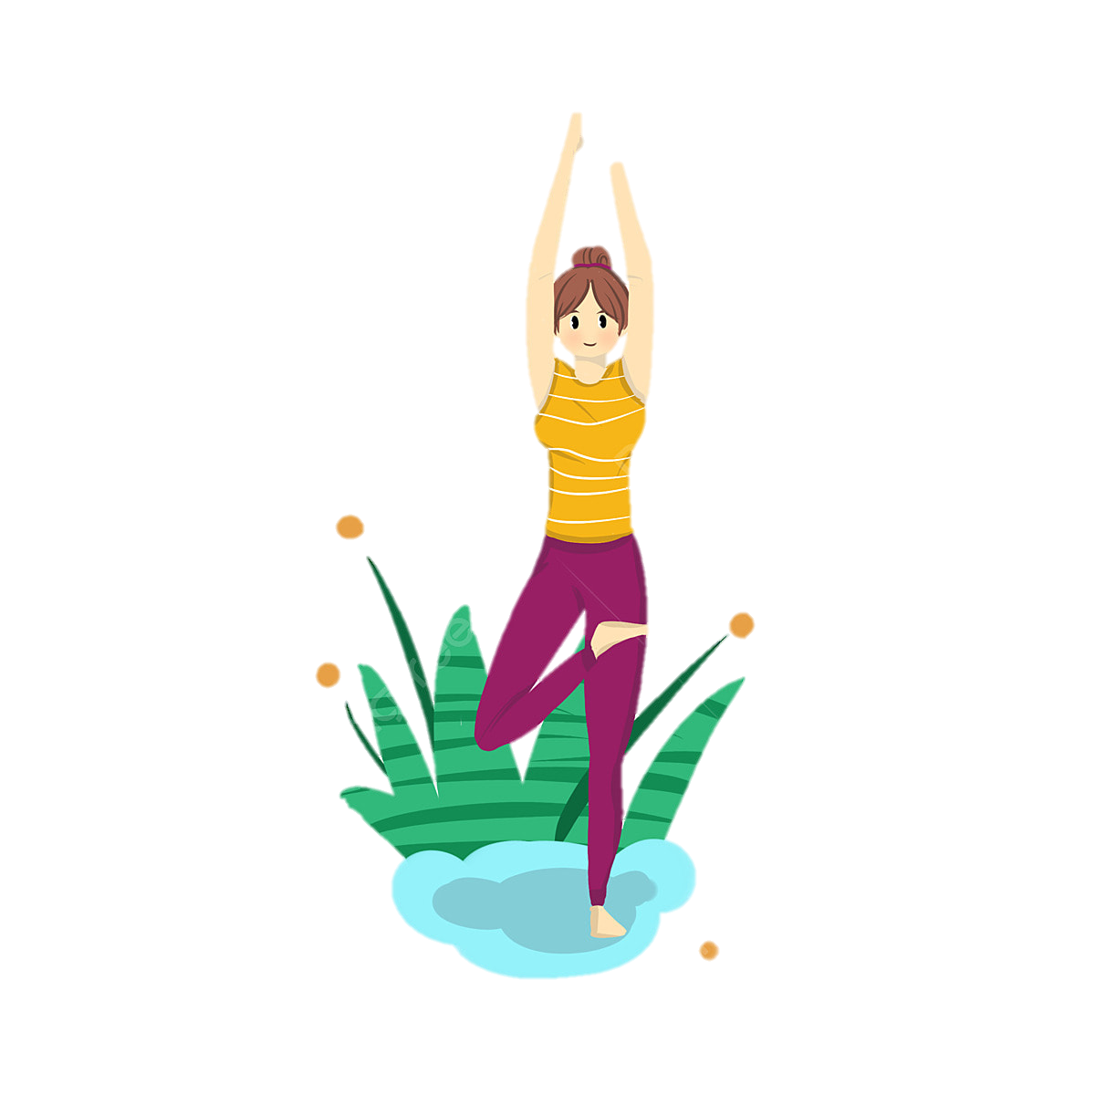
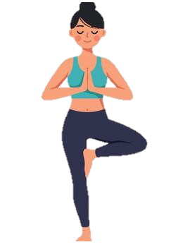
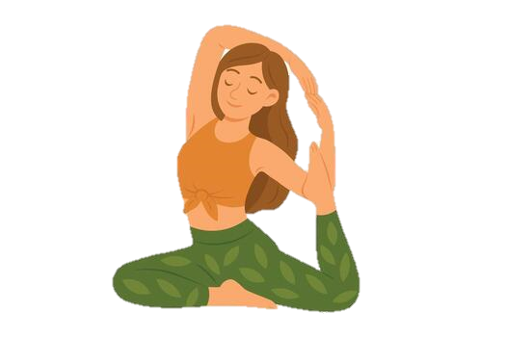
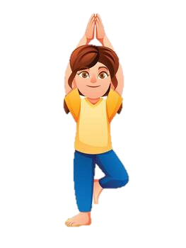
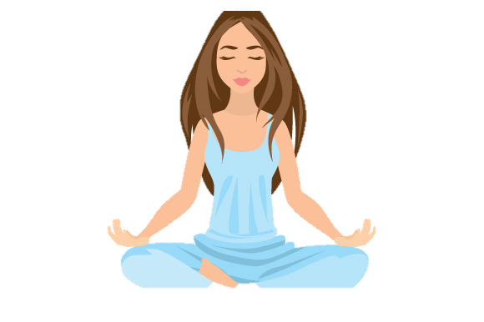
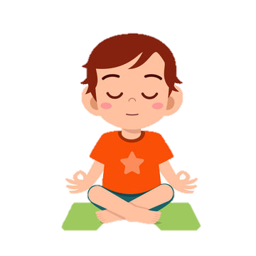

INTRODUCTION
YOGA
Mind body practice for health, flexibility, relaxation, and spiritual connection
Introduction

Slide 2
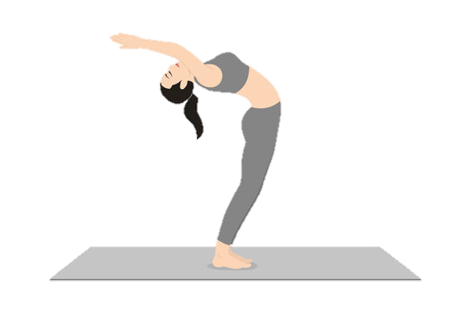
Definition of Yoga
INTRODUCTION
According to Yogasutra of Patanjali
‘Yoga is restraint of the activities of the mind’.
According to Bhagavad-Gita Yoga:
‘Evenness (of mind) is Yoga’ (2/48)
‘Yoga is Skillfulness in Action’.
Yoga is an ancient holistic discipline from India designed to harmonize the mind ,body , and spirit through physical poses (asanas), breathing techniques (pranayama), and meditation. Derived from the Sanskrit root “yuj” (to yoke or unite), it aims to unite individual consciousness with universal consciousness.

Slide 3
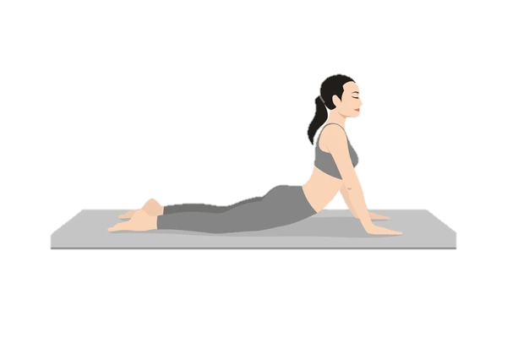
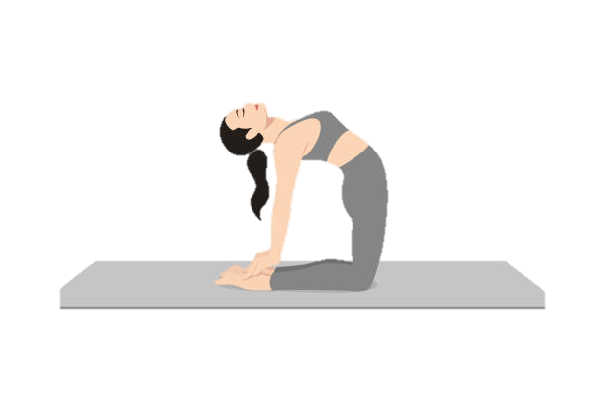
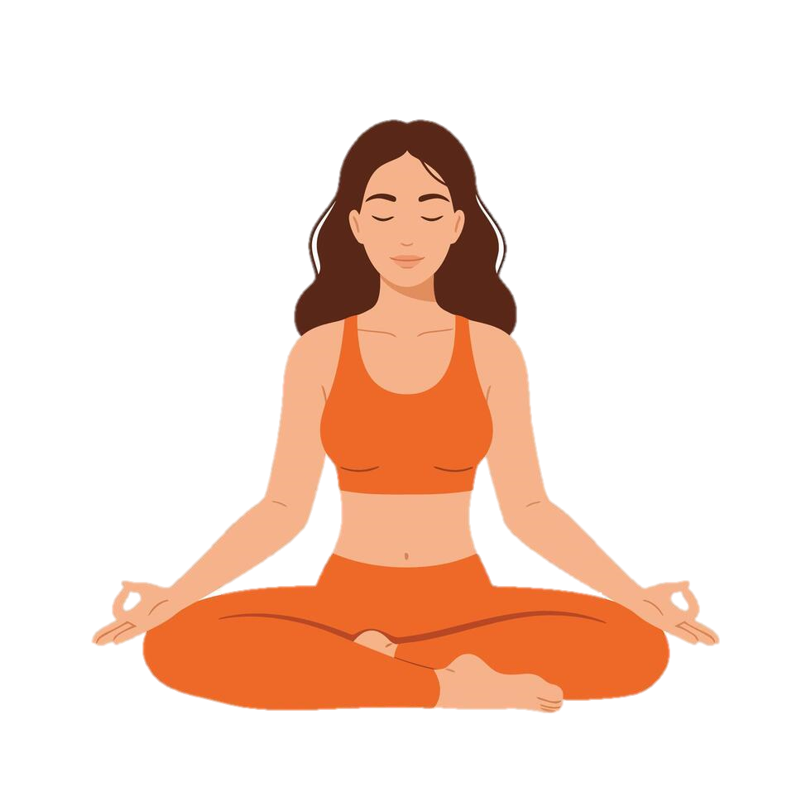
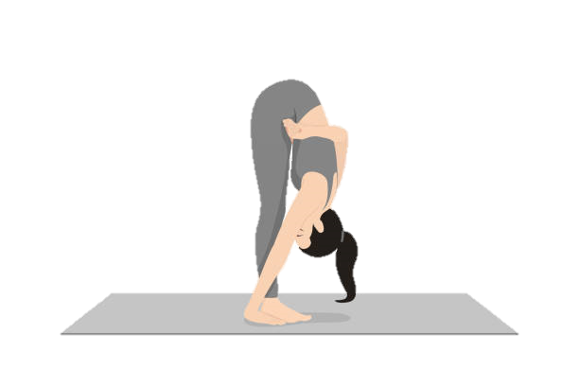
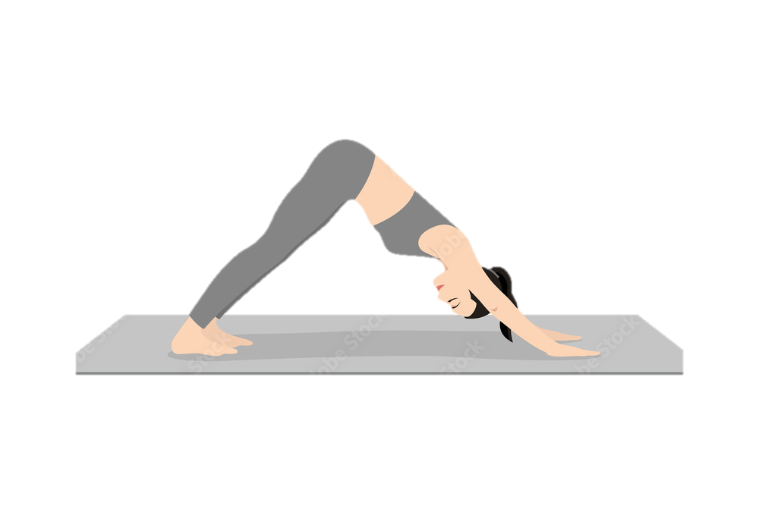
Definition of Yoga
Types of yoga asanas
According to Yogasutra of Patanjali ‘Yoga is restraint of the activities of the mind’.
According to Bhagavad-Gita Yoga:
‘Evenness (of mind) is Yoga’ (2/48)
‘Yoga is Skillfulness in Action’.
Introduction

Slide 4
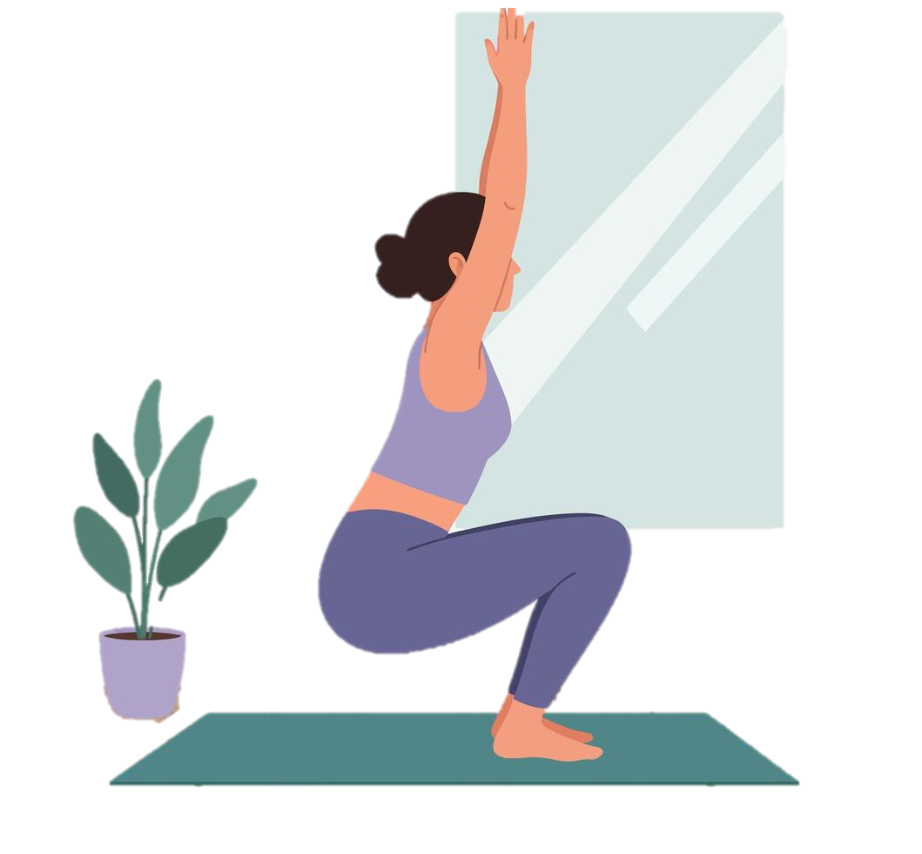
History
There is no consensus on yoga’s chronology or origins other than its development in ancient India. There are two broad theories explaining the origins of yoga. The linear model holds that yoga has Vedic origins (as reflected in Vedic texts), and influenced Buddhism.

Slide 5

Traditions
Yoga has been a central practice in Jainism. Jain spirituality is based on a strict code of nonviolence, or ahimsa (which includes vegetarianism), almsgiving (dana), faith in the three jewels, austerities (tapas) such as fasting, and yoga. Jain yoga aims at the liberation and purification of the self from the forces of karma, which binds the self to the cycle of reincarnation.

Slide 6

Health Benefits Of Yoga
7.Dhyana
Meditation
8.Samadhi
union
Types of yoga asanas
Many yoga poses stretch muscles and joints that are rarely used, this will help joints, ligaments and tendons.
Some yoga poses are especially good for organs that are rarely stimulated externally. This keeps the organs healthy and helps yours body fight off disease.
Many yoga poses require you to support your weight on your own. All yoga poses need good balance. These poses are done slowly but precisely, which helps build strength and endurance.
6.Dharana
concentration
5.Pratyahara
Withdrawl of senses
3.Asana
Movement and posture
4.Pranayama
Breath
1.Yama
Self-restraint
2.Niyama
Observation

Slide 7
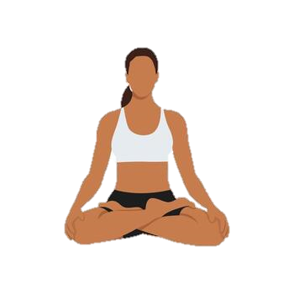
7.Dhyana
Meditation
8.Samadhi
union
Types of yoga asanas
Uatrasana
(camel pose)
Padmasana
(Cobra pose)
6.Dharana
concentration
5.Pratyahara
Withdrawl of senses
3.Asana
Movement and posture
4.Pranayama
Breath
Padmasana
(Lotus pose)
1.Yama
Self-restraint
2.Niyama
Observation
Padmasana
(forward fold)
Svanasana
(downward facing dog)
The Eight Limbs Of YOGA

Slide 8
1.Samadhi
union
Eight Limbs Of YOGA
2.Dhyana
Meditation
3.Dharana
concentration
4.Pratyahara
Withdrawl of senses
5.Pranayama
Breath
6.Asana
Movement and posture
7.Niyama
Observation
8.Yama
Self-restraint

Slide 9
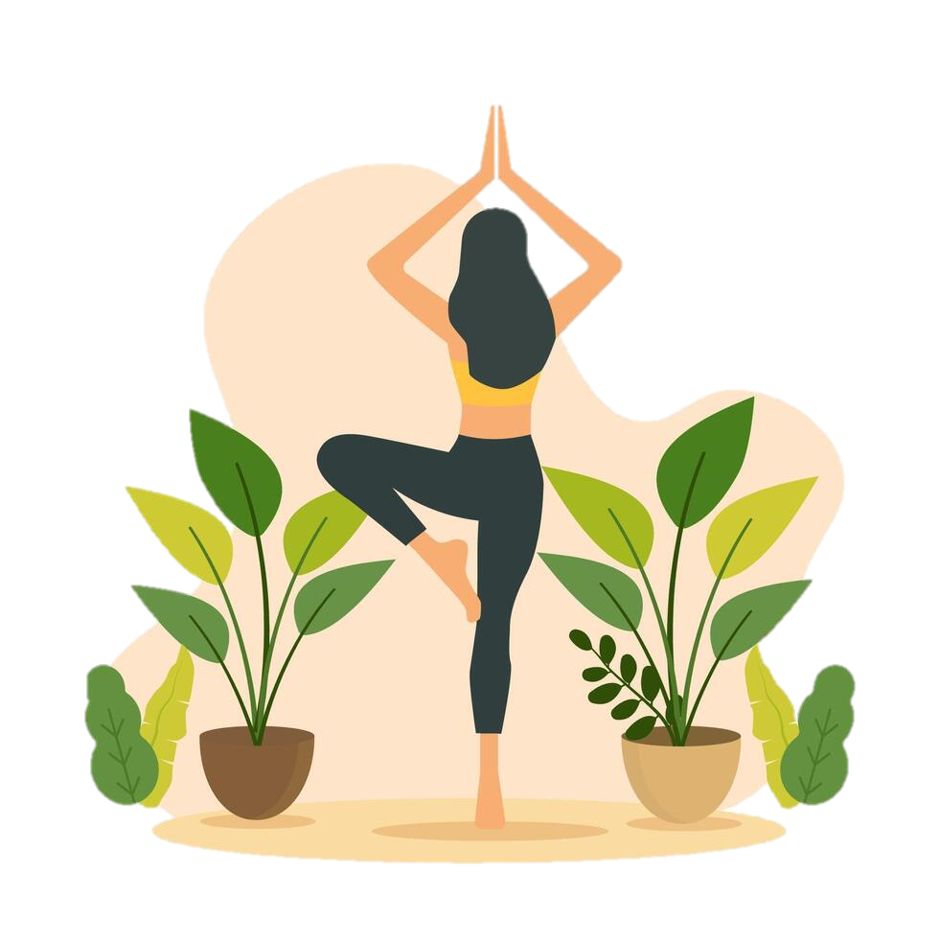
Importances Of Yoga
Yoga helps in maintaining an appropriate posture
It makes us resilient to daily stressors
It improves our flexibility
It helps maintain muscle health and strengthens them

Slide 10
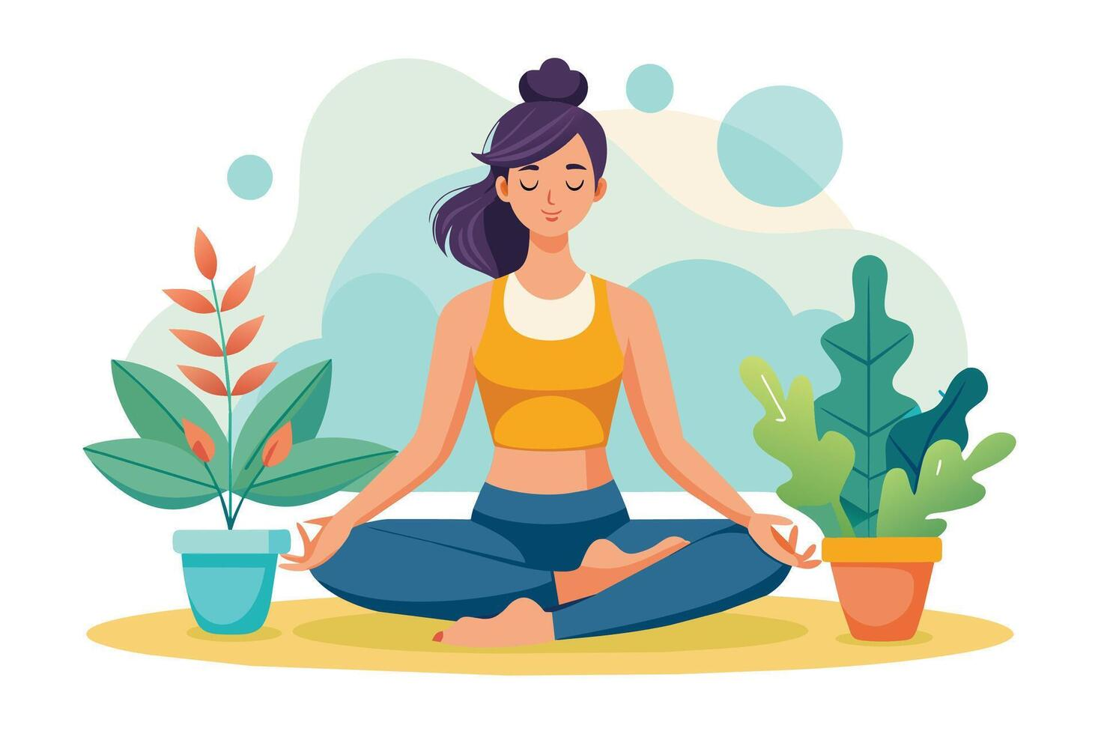
Thanks For Watching

